Slide 1

Southern California Water Dialogue
February 26, 2014

Slide 2
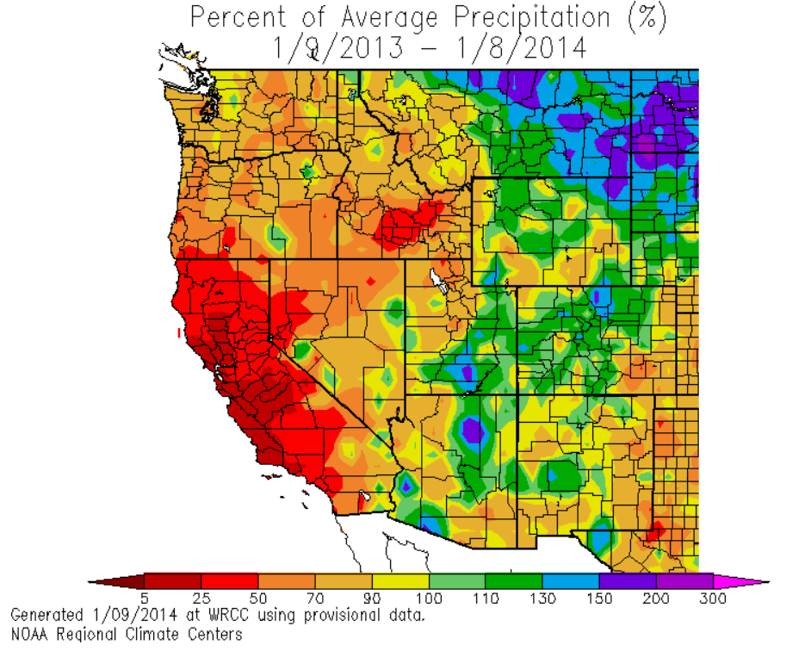
2013 Hydrologic Conditions
Percent of Average Precipitation (%)
Calendar Year 2013
Driest Calendar Year
on Record
Notes:
Message, we are prepared for a dry year

Slide 3
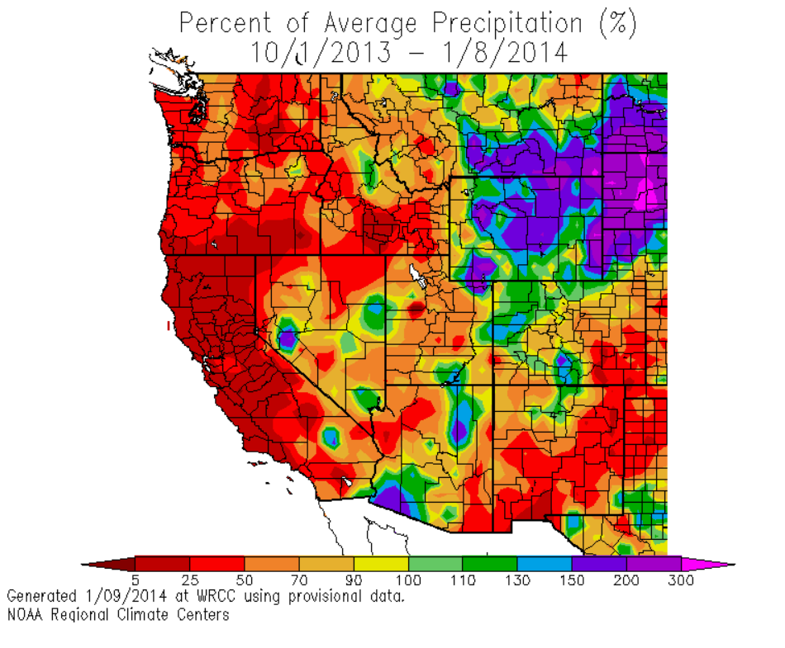
2014 Hydrologic Conditions
Percent of Average Precipitation (%) 10/1/2013 – 1/31/2014
Percent of Average Precipitation (%)
Oct 2013 – Jan 2014
Driest Oct-Jan
on Record
17%
Notes:
Message, we are prepared for a dry year

Slide 4
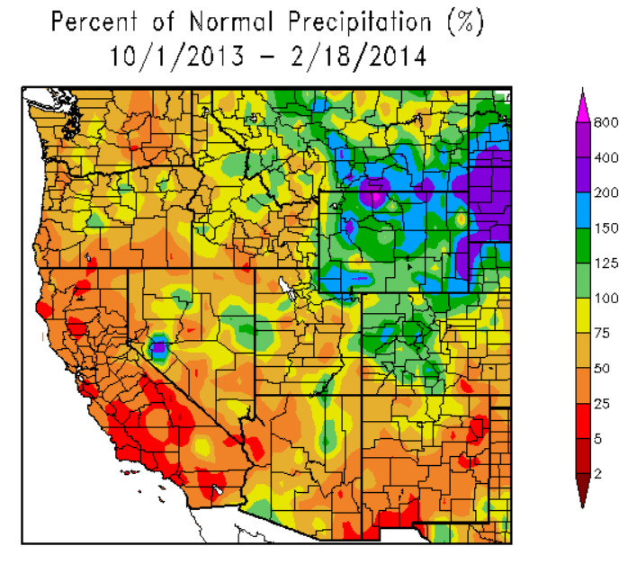
2014 Hydrologic Conditions
Percent of Average Precipitation (%)
Water Year to Date
Still Below Average
41%
Notes:
Message, we are prepared for a dry year

Slide 5
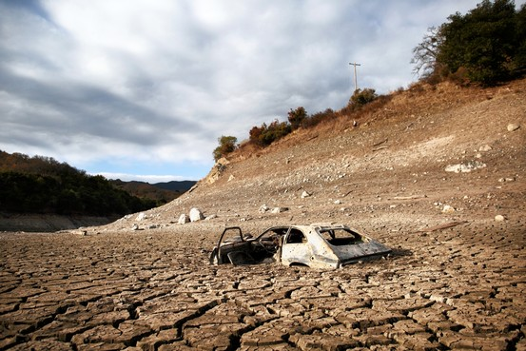
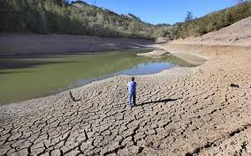
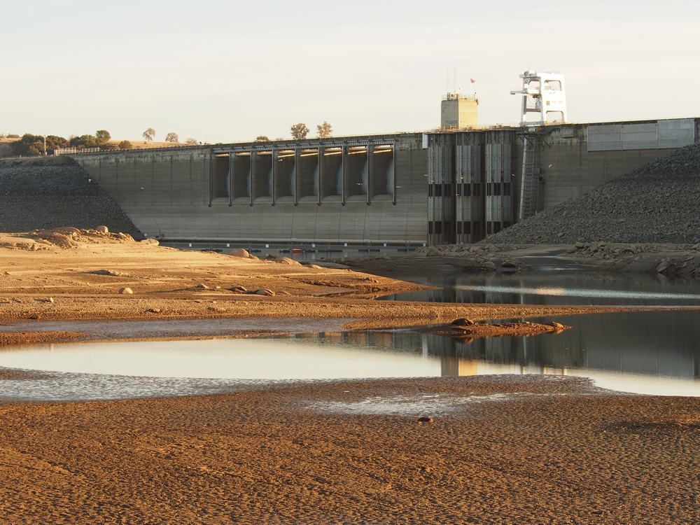
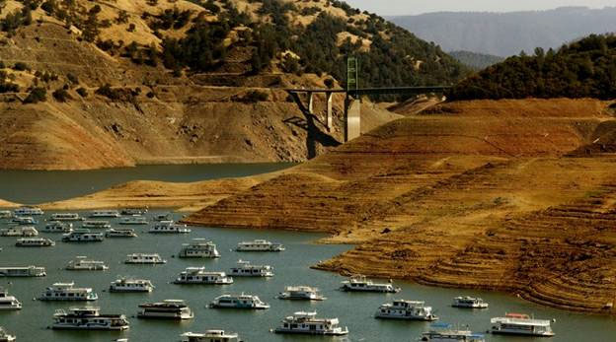
Statewide Impacts
Lake Ghisolfo, Calistoga
January 2014
Almaden Reservoir, San Jose
January 2014
Folsom Lake, Sacramento
January 2014
Lake Oroville
December 2013
Notes:
Message, we are prepared for a dry year

Slide 6
State of California Drought Emergency
Governor Brown declaration on January 17
“Perhaps the worst drought California has seen since records began being kept”
Calls for citizens to do their part and reduce water use by 20 percent
Looks to clear the way for water transfers and exchanges

Slide 7
Recent Events
Second snow survey is only 12% of normal snowpack to date (expected to improve)
DWR reduced the SWP Table A Allocation to zero percent (January 31)
SWRCB granted a joint DWR/USBR petition
  Reduces Delta Outflow requirements to minimum
  Provides flexibility in Delta Cross Channel operations

Slide 8
Northern Sierra Hydrologic Conditions
Eight Station Index WY 1922-2013
Before Storm
Max88.5
17%
Avg50.4
46.2
Min17.1
4.5
Notes:
Max 1982-83
Min 1923-24
Avg 1922-2013
last year (WY 2013) 46.2” ~95% of average
This year (WY 2014) 4.5” through end of Jan, ~17% of average
Jan 1.2”, 14% of normal

Slide 9
Northern Sierra Hydrologic Conditions
Eight Station Index WY 1922-2013
After Storm
Max88.5
41%
Avg50.4
46.2
Min17.1
12.9
4.5
Notes:
This year (WY 2014) 11.8” through 2/11, ~39% of average
Gain of 7.3” in Feb so far

Slide 10
Northern Sierra Hydrologic Conditions
Eight Station Index WY 1922-2013
Max88.5
Avg50.4
46.2
Min17.1
Notes:
This year (WY 2014) 11.8” through 2/11, ~39% of average
Gain of 7.3” in Feb so far

Slide 11
Colorado River Hydrologic Conditions
Upper Colorado Basin Snowpack
Before Storm
96%
9.7
Notes:
6.6” at the end of Dec
9.7” at the end of Jan, for a gain of 3.1”
101% of normal to date
As of Yesterday (2/9)
10.6”
112% of normal to date

Slide 12
Colorado River Hydrologic Conditions
Upper Colorado Basin Snowpack
After Storm
112%
11.5
Notes:
6.6” at the end of Dec
9.7” at the end of Jan, for a gain of 3.1”
101% of normal to date
As of Yesterday (2/9)
10.6”
112% of normal to date

Slide 13

Probability of Surplus/Shortage Based on January 2014 Conditions
Year | Surplus | Shortage
2014 | 0% | 0%
2015 | 0% | 0%
2016 | 4% | 44%
2017 | 7% | 54%
2018 | 12% | 54%
2019 | 15% | 56%
2020 | 21% | 58%

Slide 14
2014 Available Supply
Based on Currently Allocated Supplies
Winter storms may improve the
SWP Allocation
SWP: 600 TAF
  Table A Allocation: 0
  Storage & Programs: 600 TAF
CRA: 1.2 MAF
  Priority 4: 550 TAF
  Colorado System Storage & Programs:
  650 TAF

Slide 15
2014 Supply and Demand Balance
Based on Currently Allocated Supplies and Demands
Supply/Demand Balance | Acre-Feet
SWP Supply | 600,000
CRA Supply | 1,200,000
Total Supply | 1,800,000
Total Demand | 2,000,000
In-Region Storage Requirement | 200,000

Slide 16
2014 Supply and Demand Balance
SWP improvement can increase supplies

Slide 17
2014 Supply and Demand Balance
Conservation reduces storage depletion

Slide 18
MWD Storage Reserves
End of Year Balances*
*Estimated actual storage balances, may be subject to change.
Notes:
Message, we are prepared for a dry year!
2013 ending balance - 2.353 MAF, rounds to 2.4 MAF

Slide 19
MWD Storage Reserves
End of Year Balances*
Storage use will vary based on actual conditions
*Estimated actual storage balances, may be subject to change.
Notes:
Message, we are prepared for a dry year!
2013 ending balance - 2.353 MAF, rounds to 2.4 MAF

Slide 20
Diversification of Water Portfolio
Early 1990’s
2010 IRP Strategy
Heavy dependence on
imported supply
and SWP Diversions
Emphasis on Conservation, Local Supplies, and
Storage & Transfers
CURRENT AS OF 051711
Notes:
Message Points
Emphasize the impact of the IRP plan on how we plan for dry years
Prior to IRP, dependence on imported supply, but especially dry-year diversions from the SWP
Not a good strategy, with hydrologic and regulatory constraints highest in dry years
With development of sustainable local supplies, conservation, and implementation of storage and transfers, there is a reduction on dependence on SWP dry-year diversions
More solid strategy, with movement of water into storage in wetter years where constraints are more relaxed

Slide 21
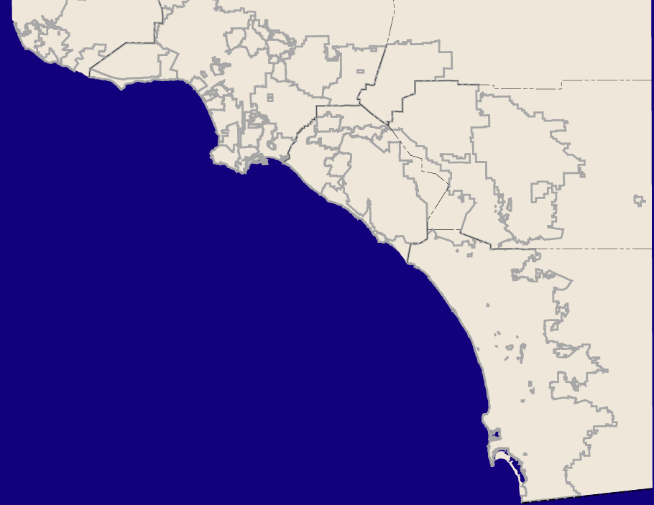
Regional Investments
Reducing Reliance on Imports
Conservation: 900,000 af/yr
Recycling: 335,000 af/yr
Groundwater Recovery: 111,000 af/yr
Seawater: 46,000 af/yr (planned)
Conservation represents regional actions both active & passive
Recycling & groundwater represents total regional production 2012 (MWD & member agency)
Seawater represents 3 planned local projects
Notes:
Metropolitan and its member agencies have made significant investments in developing local resources to improve efficiencies and reduce the reliance on imported water from both the State Water Project and Colorado River.
Annual water savings include:
Conservation programs saving approximately 900,000 acre-feet
Recycling programs saving over 335,000 acre-feet
Groundwater recovery programs saving more than 111,000 acre-feet
And investments in seawater desalination programs that are currently in different stages of planning will save approximately 46,000 acre-feet per year.
Seawater Desalination Projects
Metropolitan has signed incentive agreements with Long Beach, MWDOC and West Basin.
Incentives modeled after LRP: up to $250 per acre-foot once project is delivering supplies
Pilot study phases, expected capacity: 46,000 AFY; 2017-2020 on-line dates
Carlsbad Project: SDCWA and Poseidon:
MWD incentive agreement deferred
56,000 capacity; 48,000 minimum purchase
SDCWA approved Water Purchase Agreement with Poseidon – 2016 on-line target
Total all-in costs of project: $2,041 - $2,290
Other potential projects:
Poseidon Huntington Beach project: permitting phase; 56,000 AFY
SDCWA: Camp Pendleton: study phase: 56,000 – 168,000 AFY
Rosarito Beach (Mexico); two projects, feasibility phase; SoCal would get a portion of supply

Slide 22
MWD Storage Capacity
Mojave Amendment
Additional Lake Mead
Lake Mead Demo
13x Increase in Capacity
Mojave Demo & Additional Prop. 13
Kern Delta Prop. 13 Programs
Diamond Valley Lake
Arvin Edison
Castaic & Perris
Desert / Coachella
Semitropic
Lake Mathews
& Lake Skinner
Notes:
1980 – Lake Matthews and Skinner
1990 – Desert and Coachella
1995 – Semitropic, Castaic and Perris under Monterey Agreement
1998 - Arvin Edison
2000 – DVL
2003 – Kern-Delta and Prop 13 conjunctive use programs
2006 – Mojave Demo and Additional Prop 13 conjunctive use programs
2007 – Lake Mead Demo
2008 – Established Lake Mead storage (1.5 MAF Capacity 400AF max draw)

Slide 23
Summary
Unprecedented conditions
Metropolitan’s IRP has prepared
  Metropolitan is prepared to use storage to meet demands
  Water use efficiency is key region-wide
Metropolitan is taking drought actions
  Water Supply Alert
  Conservation and Recycled Water Budget
  Coordination with other agencies

Slide 24


Slide 25
Regional Investments
Reducing Reliance on Imports
Conservation: 900,000 af/yr
Recycling: 335,000 af/yr
Groundwater Recovery: 111,000 af/yr
Seawater: 46,000 af/yr (planned)
Conservation represents regional actions both active & passive
Recycling & groundwater represents total regional production 2012 (Metropolitan & member agency)

